Slide 1
MATH 1550
Highlights of the Syllabus

Slide 2
Who I Am and How to Contact Me
Instructor: Casey Brito
Office: MA 240
E-mail: casey.brito@ttu.edu
(you must use your TTU e-mail to contact me via e-mail). Please put “MATH 1550” in the subject line.
Hours: Tuesdays and Thursdays, 9:30 AM – 10:30 AM, or by appointment (please schedule at least 48 hours in advance).

Slide 3

Course Textbook
Precalculus, 2nd Edition (2014) by Cynthia Young.
You do NOT need to buy an access code for online homework.

Slide 4
Course Outline
Appendix (A.2, A.6) | 2 hours
Chapter 0 | 7 hours
Chapter 1 | 6 hours
Chapter 2 | 7 hours
Chapter 3 | 6 hours
Chapter 4 | 6 hours
Chapter 5 | 4 hours
Chapter 6 | 7 hours
Chapter 7 (7.2 is optional; omit) | 5 hours
Chapter 8 (8.4 and 8.7 are optional; omit 8.4, 8.5) | 6 hours
Chapter 9 (Omit 9.5 through 9.8) | 5 hours
Chapter 10 (Omit 10.4 and 10.5) | 3 hours
Total | 64 hours
These are sections that will be covered this semester along with the approximate time to be spent on each section.

Slide 5
Methods of Assessment of Learning Outcomes
WeBWorK Homework Sets | 20%
Four in-class Exams (15% each) | 60%
Comprehensive Final Exam | 20%
Total | 100%
Assessment will be achieved through one or more activities, non-graded and graded, such as class discussion, board work, homework, examinations and other optional activities deemed appropriate by the instructor. Class grades will be assigned as shown to the left.

Slide 6
Grading Scale
A | 90% and higher
B | 80% to 89%
C | 70% to 79%
D | 60% to 69%
F | 59% and lower
These percentages will tentatively determine the letter grade assigned for the course.

Slide 7
Tentative Exam Dates
February 13, 2018
March 6, 2018
April 10, 2018
April 24, 2018

Slide 8
Calculators on Exams

Slide 9
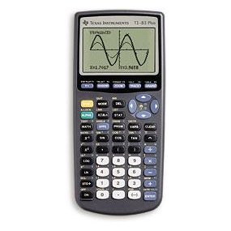
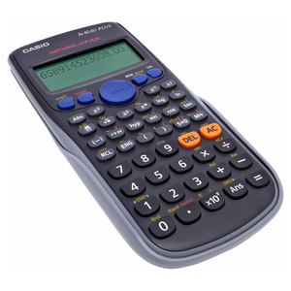
Calculators on Exams

Slide 10
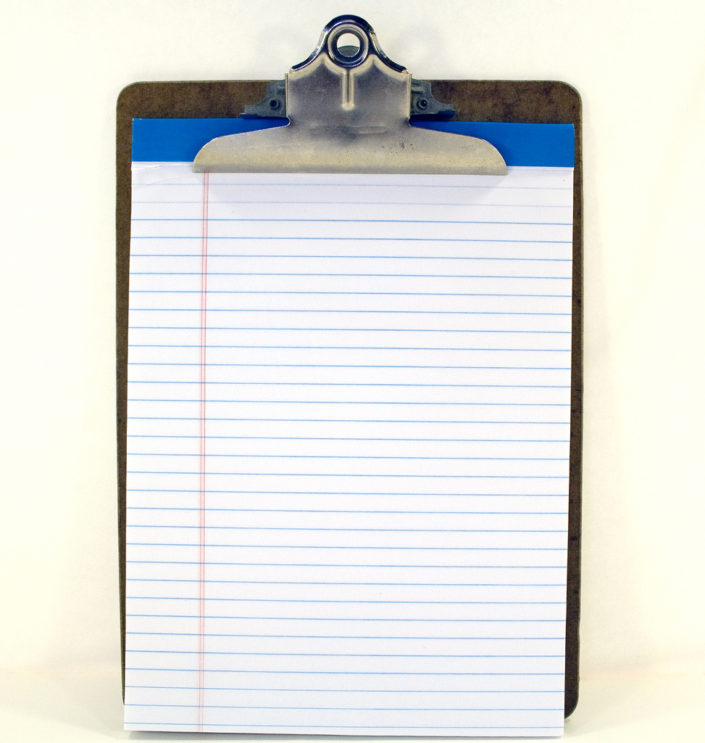
Notes on Exams

Slide 11
WeBWorK
WeBWorK is an internet-based method for delivering homework problems to students. You will need your eRaider username and student ID number with the R to log into WeBWorK.
Ex: username: eraider
password: R12345678

Slide 12
Final Exam
The common final exam is a course requirement.
A student who did not complete the final exam, but otherwise completed all the other requirements successfully, cannot be assigned a passing letter grade.
The final exam will be given in a proctored environment. The date for the final exam was scheduled prior to the start of the semester.
Tuesday, May 15, 2018 from 10:30 a.m. – 1:00 p.m..
The time and date of the exam cannot change. Students should eliminate any conflicts now.

Slide 13
Make-Ups
Only allowed if...
the absence is properly documented by doctor's note or if the student suffers an emergency (may be subject to verification by the university).
the student's absence is due to a university organized event (athletics, conference, etc.). The student should notify me in advance by submitting an official request from the relevant university body.
The Final Exam cannot be made up.

Slide 14
Class Attendance
Students are cautioned that active participation is necessary for success.
Attendance is strongly encouraged.

Slide 15
Campus Resources
Tutoring and Study Center (TSC) – a free tutoring center provided by the Mathematics & Statistics Department located at in Room 106 of the Math Building.
Learning Center – a free tutoring center located in Room 80 of Holden Hall. Online tutoring is also available.
Tutoring List – a list of tutors for hire can be found in Room 201 of the Math Building.

Slide 16
Important Dates
Last day to drop without academic penalty: Friday, February 2
Spring Break: Saturday-Sunday, March 10 – 18
Mid-semester grades due: Wednesday, March 21
Last day to drop with academic penalty: Wednesday, March 28
Easter Monday: Monday, April 2 (no class)
Last day of class: Tuesday, May 9
Departmental Common Final: Tuesday, May 16 10:30 a.m. – 1:00 p.m.

Slide 17
Civility in the Classroom
For the sake of other students and your instructor, please:
come to class on time;
do not leave early, and do not rustle papers in preparation to leave before class is over. If you must arrive late or leave early, inform the instructor in advance;
be attentive: stay awake, do not read newspapers, do not text or talk on your cell phone, and so forth; and
be quiet. Disruptive students will be asked to leave.

Slide 18
Texas Tech O.P.s and Procedures
Academic Honesty (OP 34.12): It is the aim of the faculty of Texas Tech University to foster a spirit of complete honesty and high standard of integrity. The attempt of students to present as their own any work not honestly performed is regarded by the faculty and administration as a most serious offense and renders the offenders liable to serious consequences, possibly suspension. “Scholastic dishonesty” includes, but is not limited to, cheating, plagiarism, collusion, falsifying academic records, misrepresenting facts, and any act designed to give unfair academic advantage to the student (such as, but not limited to, submission of essentially the same written assignment for two courses without the prior permission of the instructor) or the attempt to commit such an act.

Slide 19
Texas Tech O.P.s and Procedures
ADA Accommodation (OP 34.22): Any student who, because of a disability, may require special arrangements in order to meet the course requirements should contact the instructor as soon as possible to make any necessary arrangements. Students should present appropriate verification from Student Disability Services during the instructor’s office hours. Please note that instructors are not allowed to provide classroom accommodations to a student until appropriate verification from Student Disability Services has been provided. For additional information, you may contact the Student Disability Services office at 335 West Hall or 806-742-2405.

Slide 20
Texas Tech O.P.s and Procedures
Absence due to religious observance - The Texas Tech University OP 34.19 states that a student who intends to observe a religious holy day (a holy day observed by a religion whose places of worship are exempt from property taxation under Texas Tax Code Section 1.20) should make that intention known in writing to the instructor prior to the absence. A student who is absent from classes for the observance of a religious holy day shall be allowed to take an examination or complete an assignment scheduled for that day within a reasonable time after the absence. A student who is excused may not be penalized for the absence; however, as your instructor, I may respond appropriately if a student fails to complete the assignment satisfactorily. I request that notification be made in writing and submitted no later than the 20th class day of the semester.

Slide 21
Questions?

Slide 22
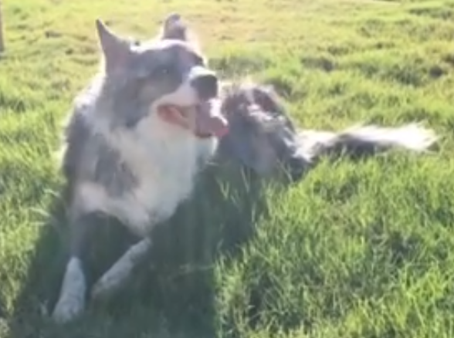
About Me
Texas Tech alumni
Mathematics, Computer Science, Engineering
Video Games and binge-watching YouTube videos

